Slide 1
Agriculture Data Spaces for Dummies
Roberto García
Universitat de Lleida
roberto.garcia@udl.cat

Slide 2
What is a Data Space?
First reference in 2005 by Franklin, Halevy and Maier [1], a shift from central databases to storing data at the source
A Data Space is a decentralised, open infrastructure for sovereign data exchange whose participants are aware and in control of the data they produce and consume as well as the involved services
No central data store, data exchange occurs directly between participants
Part of the European Strategy for Data, proposal for 9 Common European Data Spaces (CEDS):
health; industrial & manufacturing; agriculture; finance; mobility; Green Deal; energy; public administration; and skills
[1] Franklin, M., Halevy, A., and Maier, D. (2005). From databases to dataspaces: a new abstraction for information management. ACM SIGMOD Record, 34(4):27–33

Slide 3

European values for European Data Spaces design
Data Sovereignty
Data originator* can decide about its data through policies that are enforceable
* EU Code of Conduct on agricultural data sharing by contractual agreement
Low Entry Barriers
Facilitate participation while avoiding dominant players and data silos. Including participation incentives and standards
Decentralization and Interoperability
Encourage a decentralized infrastructure but aligned with federation building blocks that facilitate interoperability among data spaces
Shared Governance
All the stakeholders get a say in the data space governance

Slide 4
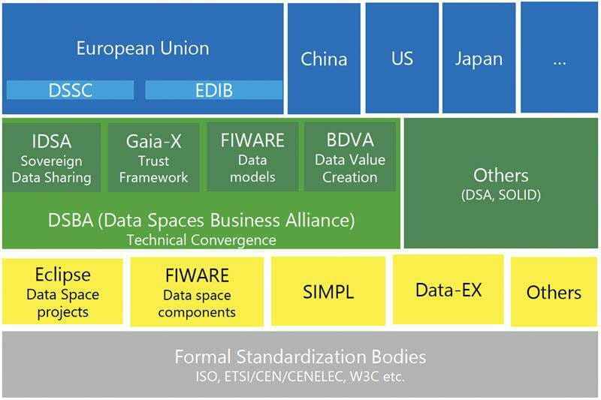
Regulatory, business, and technical foundation for Data Spaces
(source: Data Spaces Business Alliance, 2023)

Slide 5
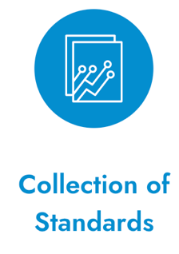
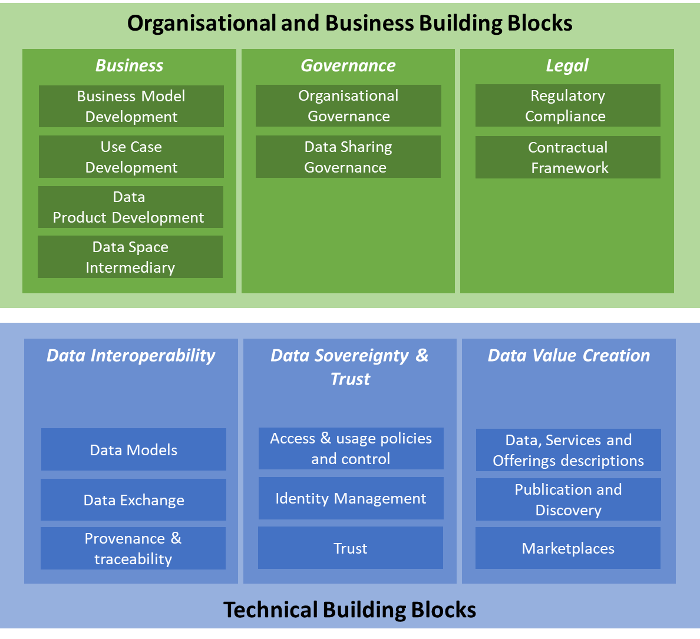
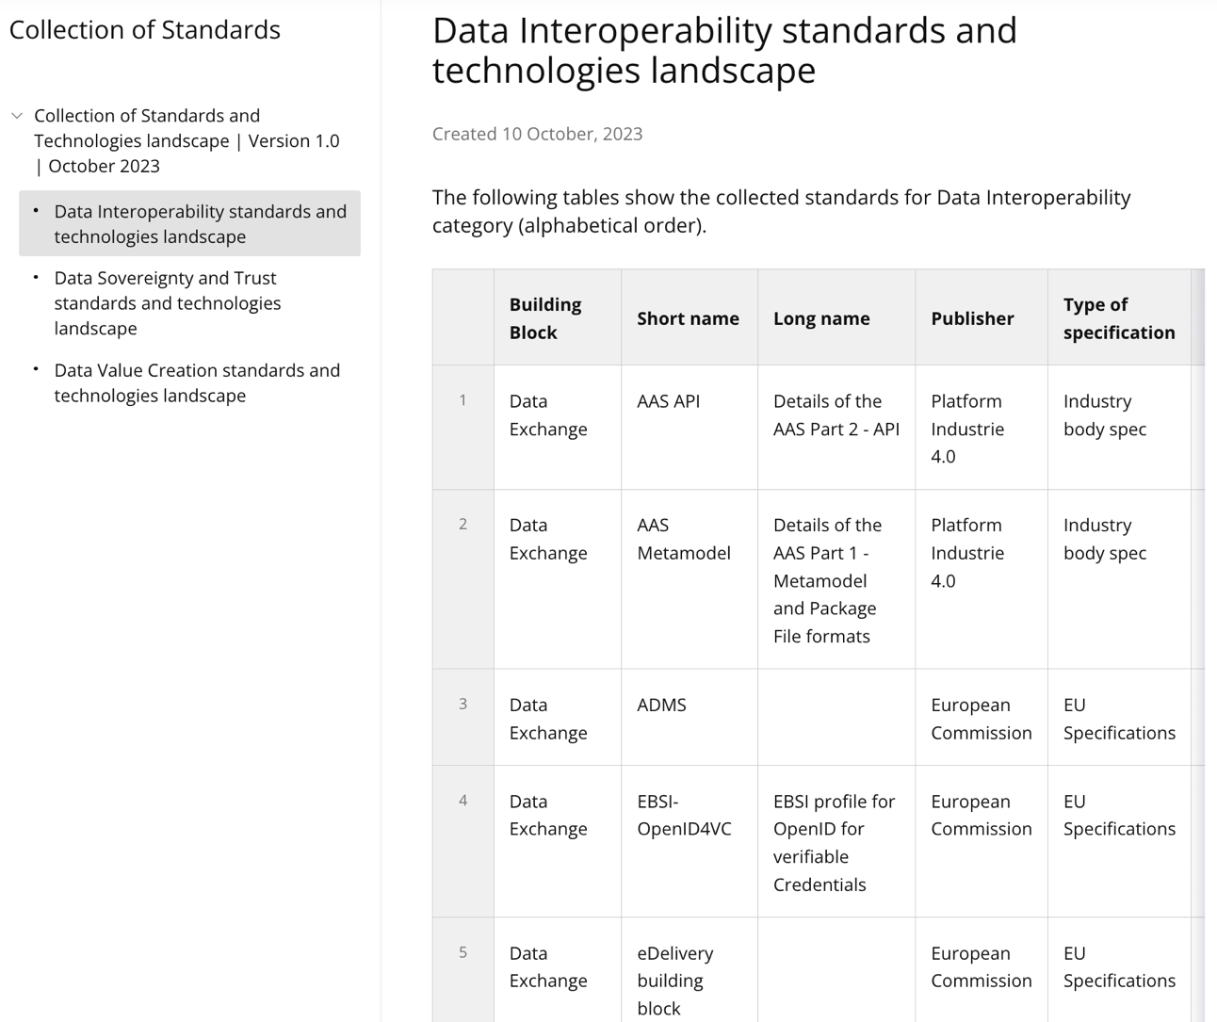
Data Spaces Support Centre
https://dssc.eu/page/knowledge-base
The Data Spaces Blueprint Version 0.5 (2023)

Slide 6
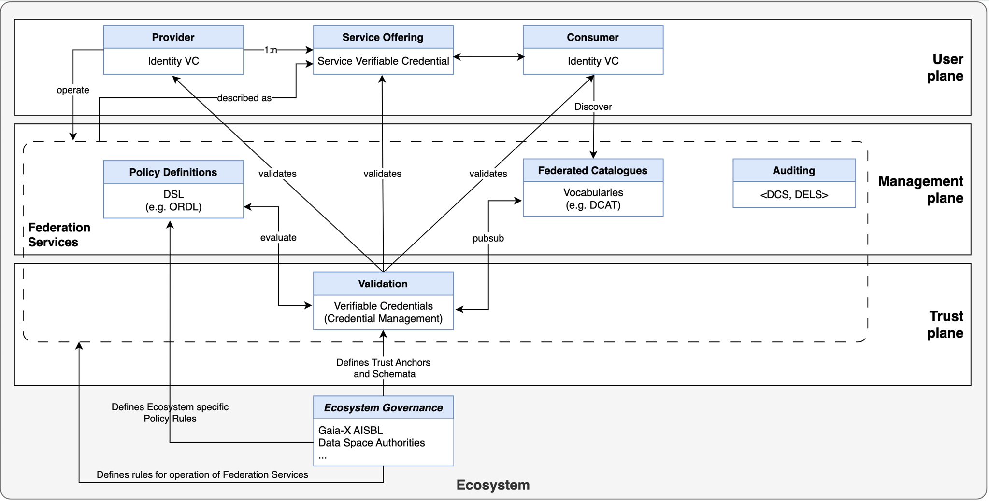
Gaia-X conceptual model overview
https://docs.gaia-x.eu/technical-committee/architecture-document/23.10/gx_conceptual_model/#overview-picture

Slide 7
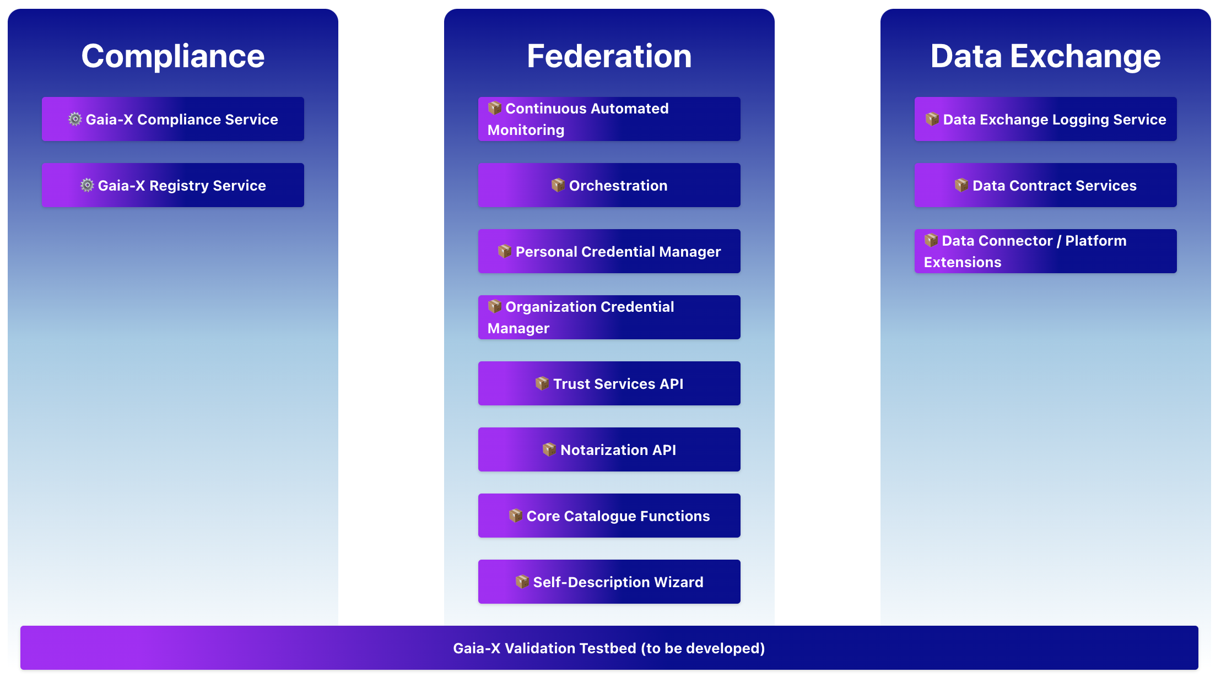
Gaia-X
https://docs.gaia-x.eu/framework/?tab=software

Slide 8
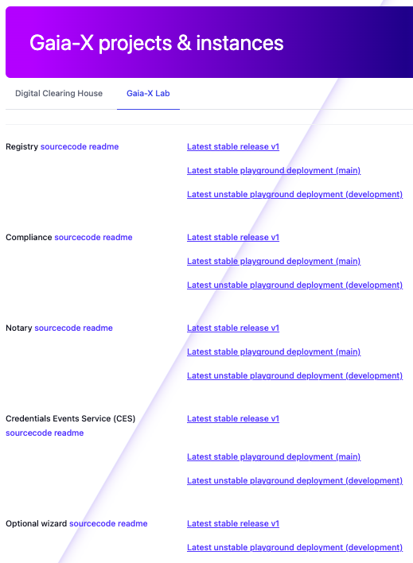
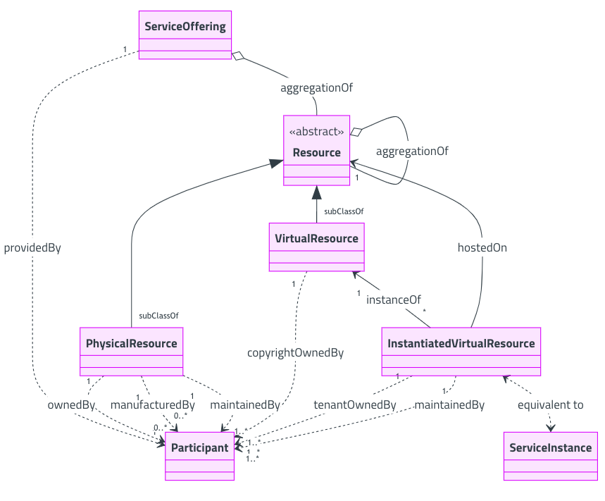
Gaia-X Digital Clearing House (GXDCH)
https://compliance.lab.gaia-x.eu
GXDCH mandatory components:
Gaia-X Compliance Service
Validates the shape, content and credentials of Self-Descriptions and issues a Verifiable Credential attesting the result if the Participant, Dataset or Service Self-Description is compliant with the Gaia-X Trust Framework
Gaia-X Registry Service:
Provides the list of valid shapes that conform the defined version of the Gaia-X. Moreover, it holds a list of valid and revoked public keys for the Gaia-X Trust Anchors
Notarisation Services:
Verifies all business registration numbers given by the participant in their Participant credentials
Credential Event Service:
Provides a distributed storing solution to synchronise the Verifiable Credentials across the Federated Catalogues
Logging Service
https://docs.gaia-x.eu/technical-committee/architecture-document/23.10/annex/#annex-a-gaia-x-digital-clearing-house-gxdch

Slide 9
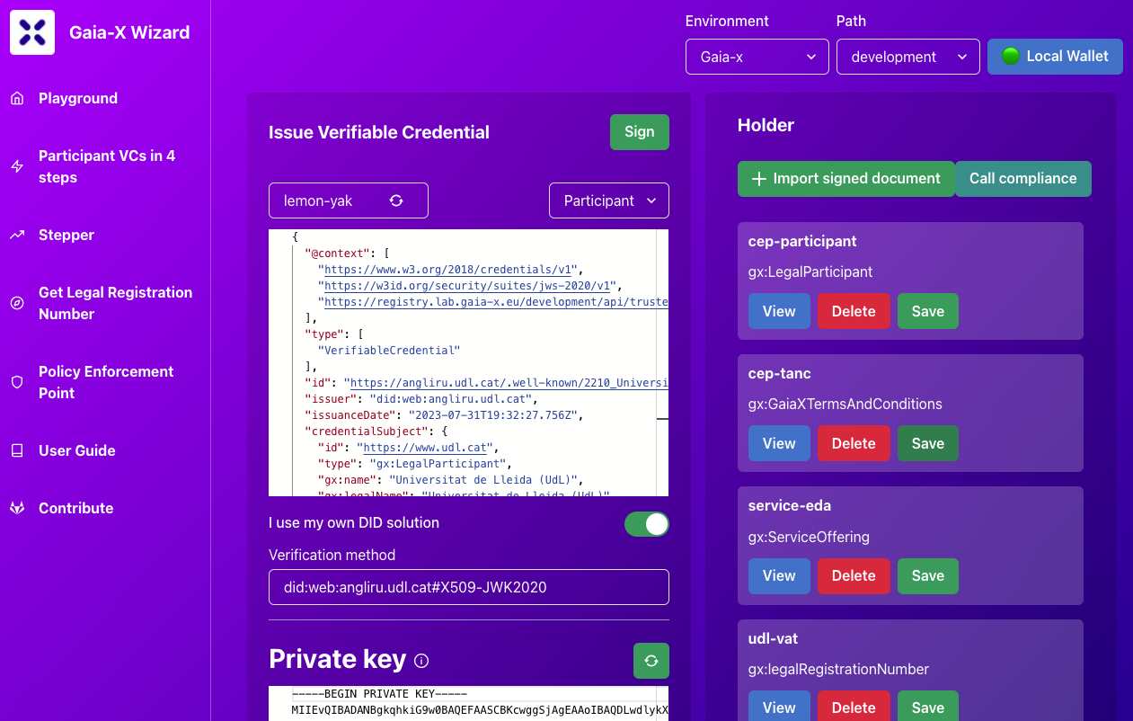
Gaia-X Digital Clearing House (GXDCH)
Optional components:
Wizard: UI to sign Verifiable Credentials in a Verifiable Presentation by calling the Gaia-X Compliance Service. It can also send the Gaia-X Compliant VCs to the Credential Events Service.
Wallet: Application that allows the user to store their Credentials and present them to third parties when needed..
Catalogue: An instance of the Federated Catalogue using the Credential Event Service.
Key Management System: to manage cryptographic material, including revocation, key rotation, key recovering,…
Policy Decision Point performs the reasoning given one or more policy and input data
Data Exchange Services
Authentication, Policy negotiation and Contracting, Catalogue, Vocabularies, Observability
Data Exchange protocols on a peer-to-peer basis, must be agreed between the parties during the contracting phase
Auditing
Data Contract Services and Data Exchange Logging Services
https://docs.gaia-x.eu/technical-committee/architecture-document/23.10/annex/#annex-a-gaia-x-digital-clearing-house-gxdch

Slide 10
Eclipse XFSC (Cross Federation Services Components)
https://projects.eclipse.org/projects/technology.xfsc
Identity, Credential and Access Management: federated ecosystems authentication and authorisation in a decentralised, self-sovereign manner
Authentication/Authorisation Service
Organisation Credential Manager
Personal Credential Manager
Trust Services API
Notarisation Service
Trust Management Infrastructure
Decentralized Catalogue and Contracting Service
Federated Catalogue: enabling participants to find each other's information and services through Self-Descriptions
Self-Description Wizard
Data Contract Services: for contract negotiations
Data Exchange Logging Service: tracking data transactions
Orchestration & Monitoring: ensuring seamless and compliant operations
Orchestration Engine: for orchestrating tasks
Service Mesh Orchestrator: designed for managing the life cycle of infrastructure services
Continuous Automated Monitoring: automated compliance monitoring
Portal: integration layer, highlighting Federation Services and providing user-friendly access to onboarding, accreditation, service discovery, orchestration, and delivery.

Slide 11
Eclipse Dataspace Components (EDC)
https://projects.eclipse.org/projects/technology.edc
Powered by the specifications of the Gaia-X AISBL Trust Framework and the IDSA Dataspace protocol
Set of components and corresponding capabilities that are mandatory to implement a dataspace:
Connector
Federated Catalog
Identity Hub
Registration Service
Data Dashboard (Management UI)
The project also provides repositories to support the onboarding of developers with with simplified, essential samplings:
Samples
Demonstrator (MVD)

Slide 12
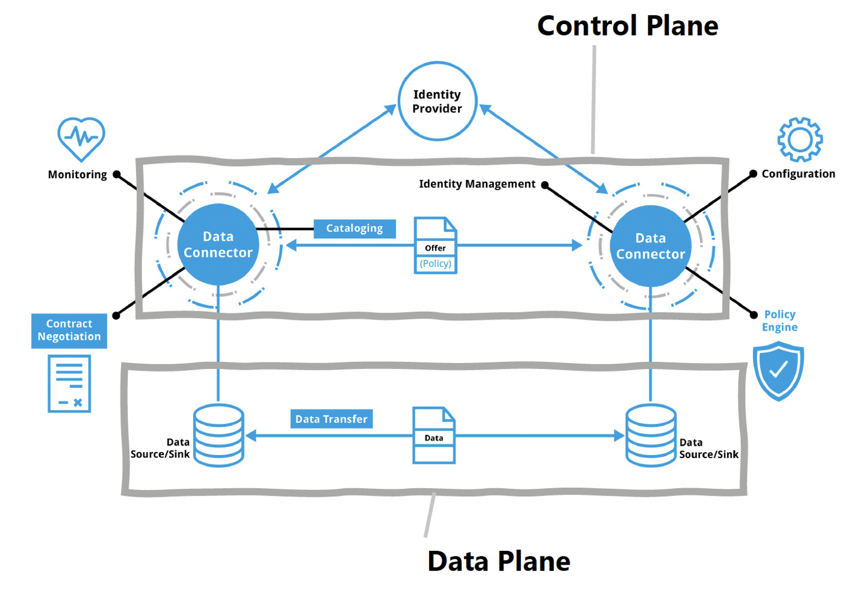
Dataspace Protocol (DSP)
Led by IDSA and implemented by the Eclipse Dataspace Working Group (EDWG)

Slide 13
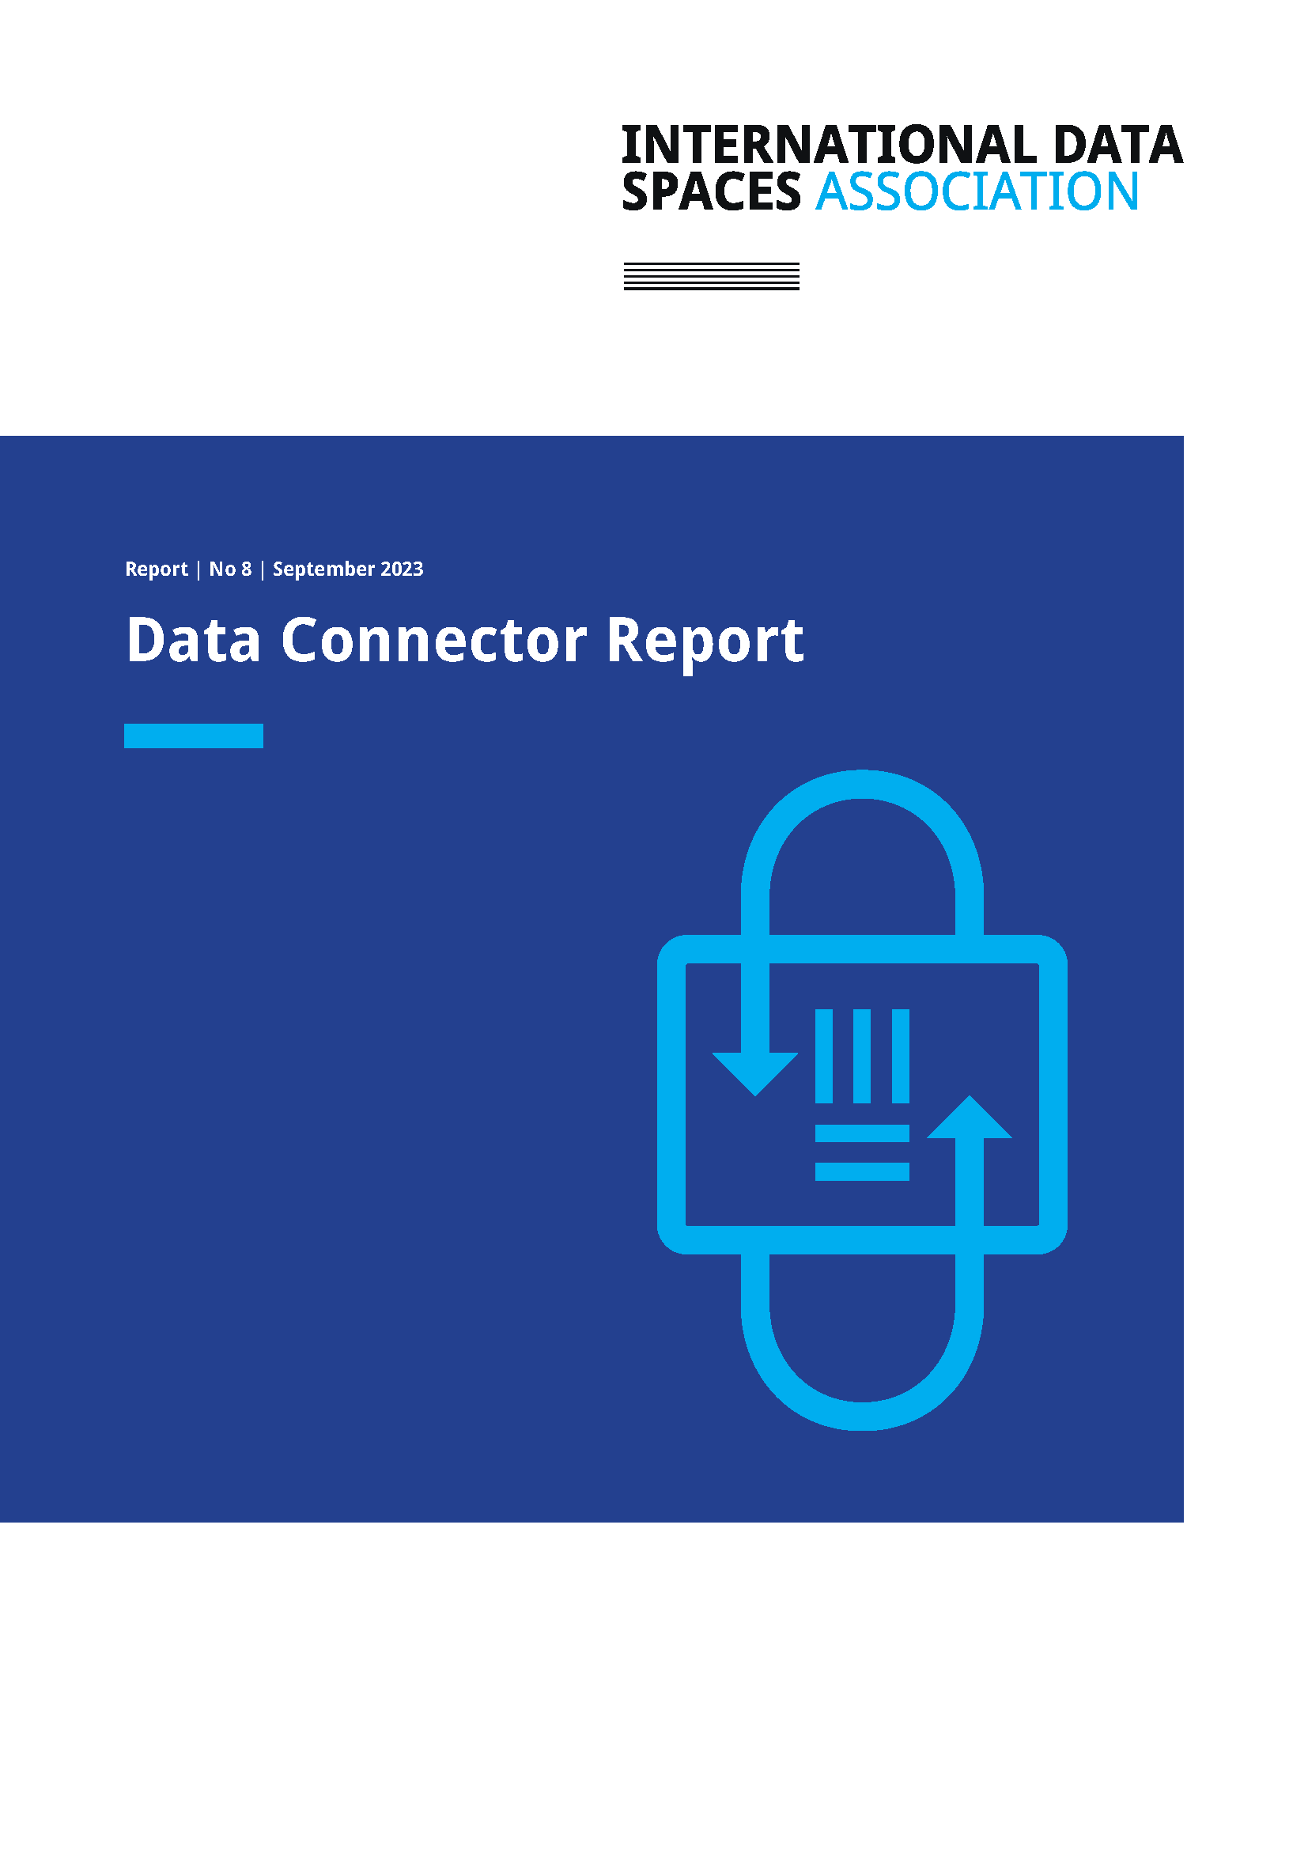
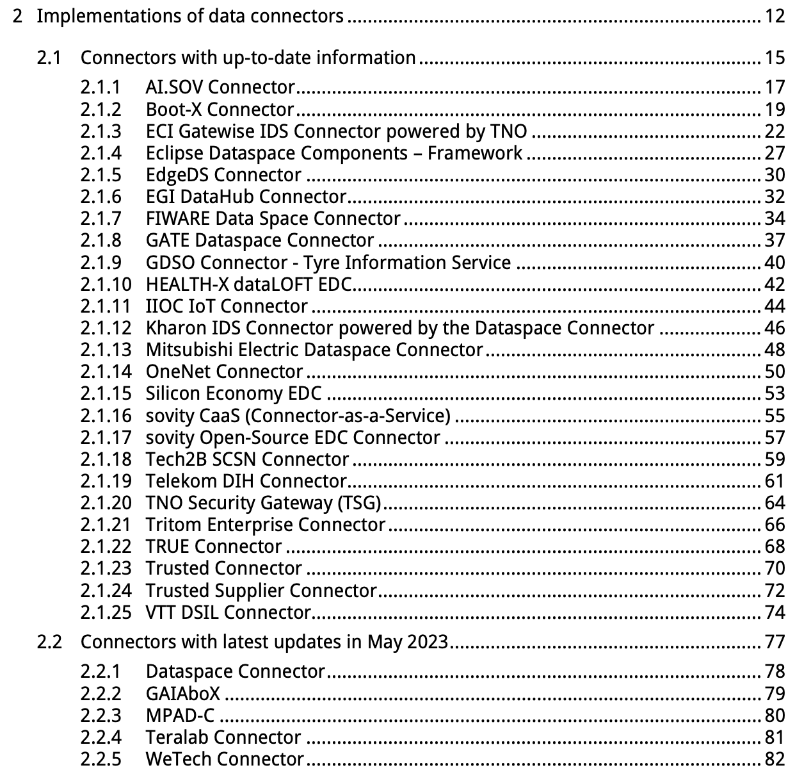
IDSA Data Connector Report January 2024 version
https://internationaldataspaces.org/data-connector-report/
3 Additional initiatives and promising emerging solutions
OKP4 Protocol: domain-specific layer-1 blockchain dedicated to trust-minimized data sharing. The blockchain orchestrates assets shared by participants: data, algorithms, software, storage and computation. Contributor earns rewards thanks to these new value chains.
Ocean Protocol and Provider: framework for data services in crypto ecosystems. Provides mechanisms for smart contracts, marketplaces, and compute-to-data.
The Provider acts as an access controller and proxy controlling access and can be compared to other connectors

Slide 14

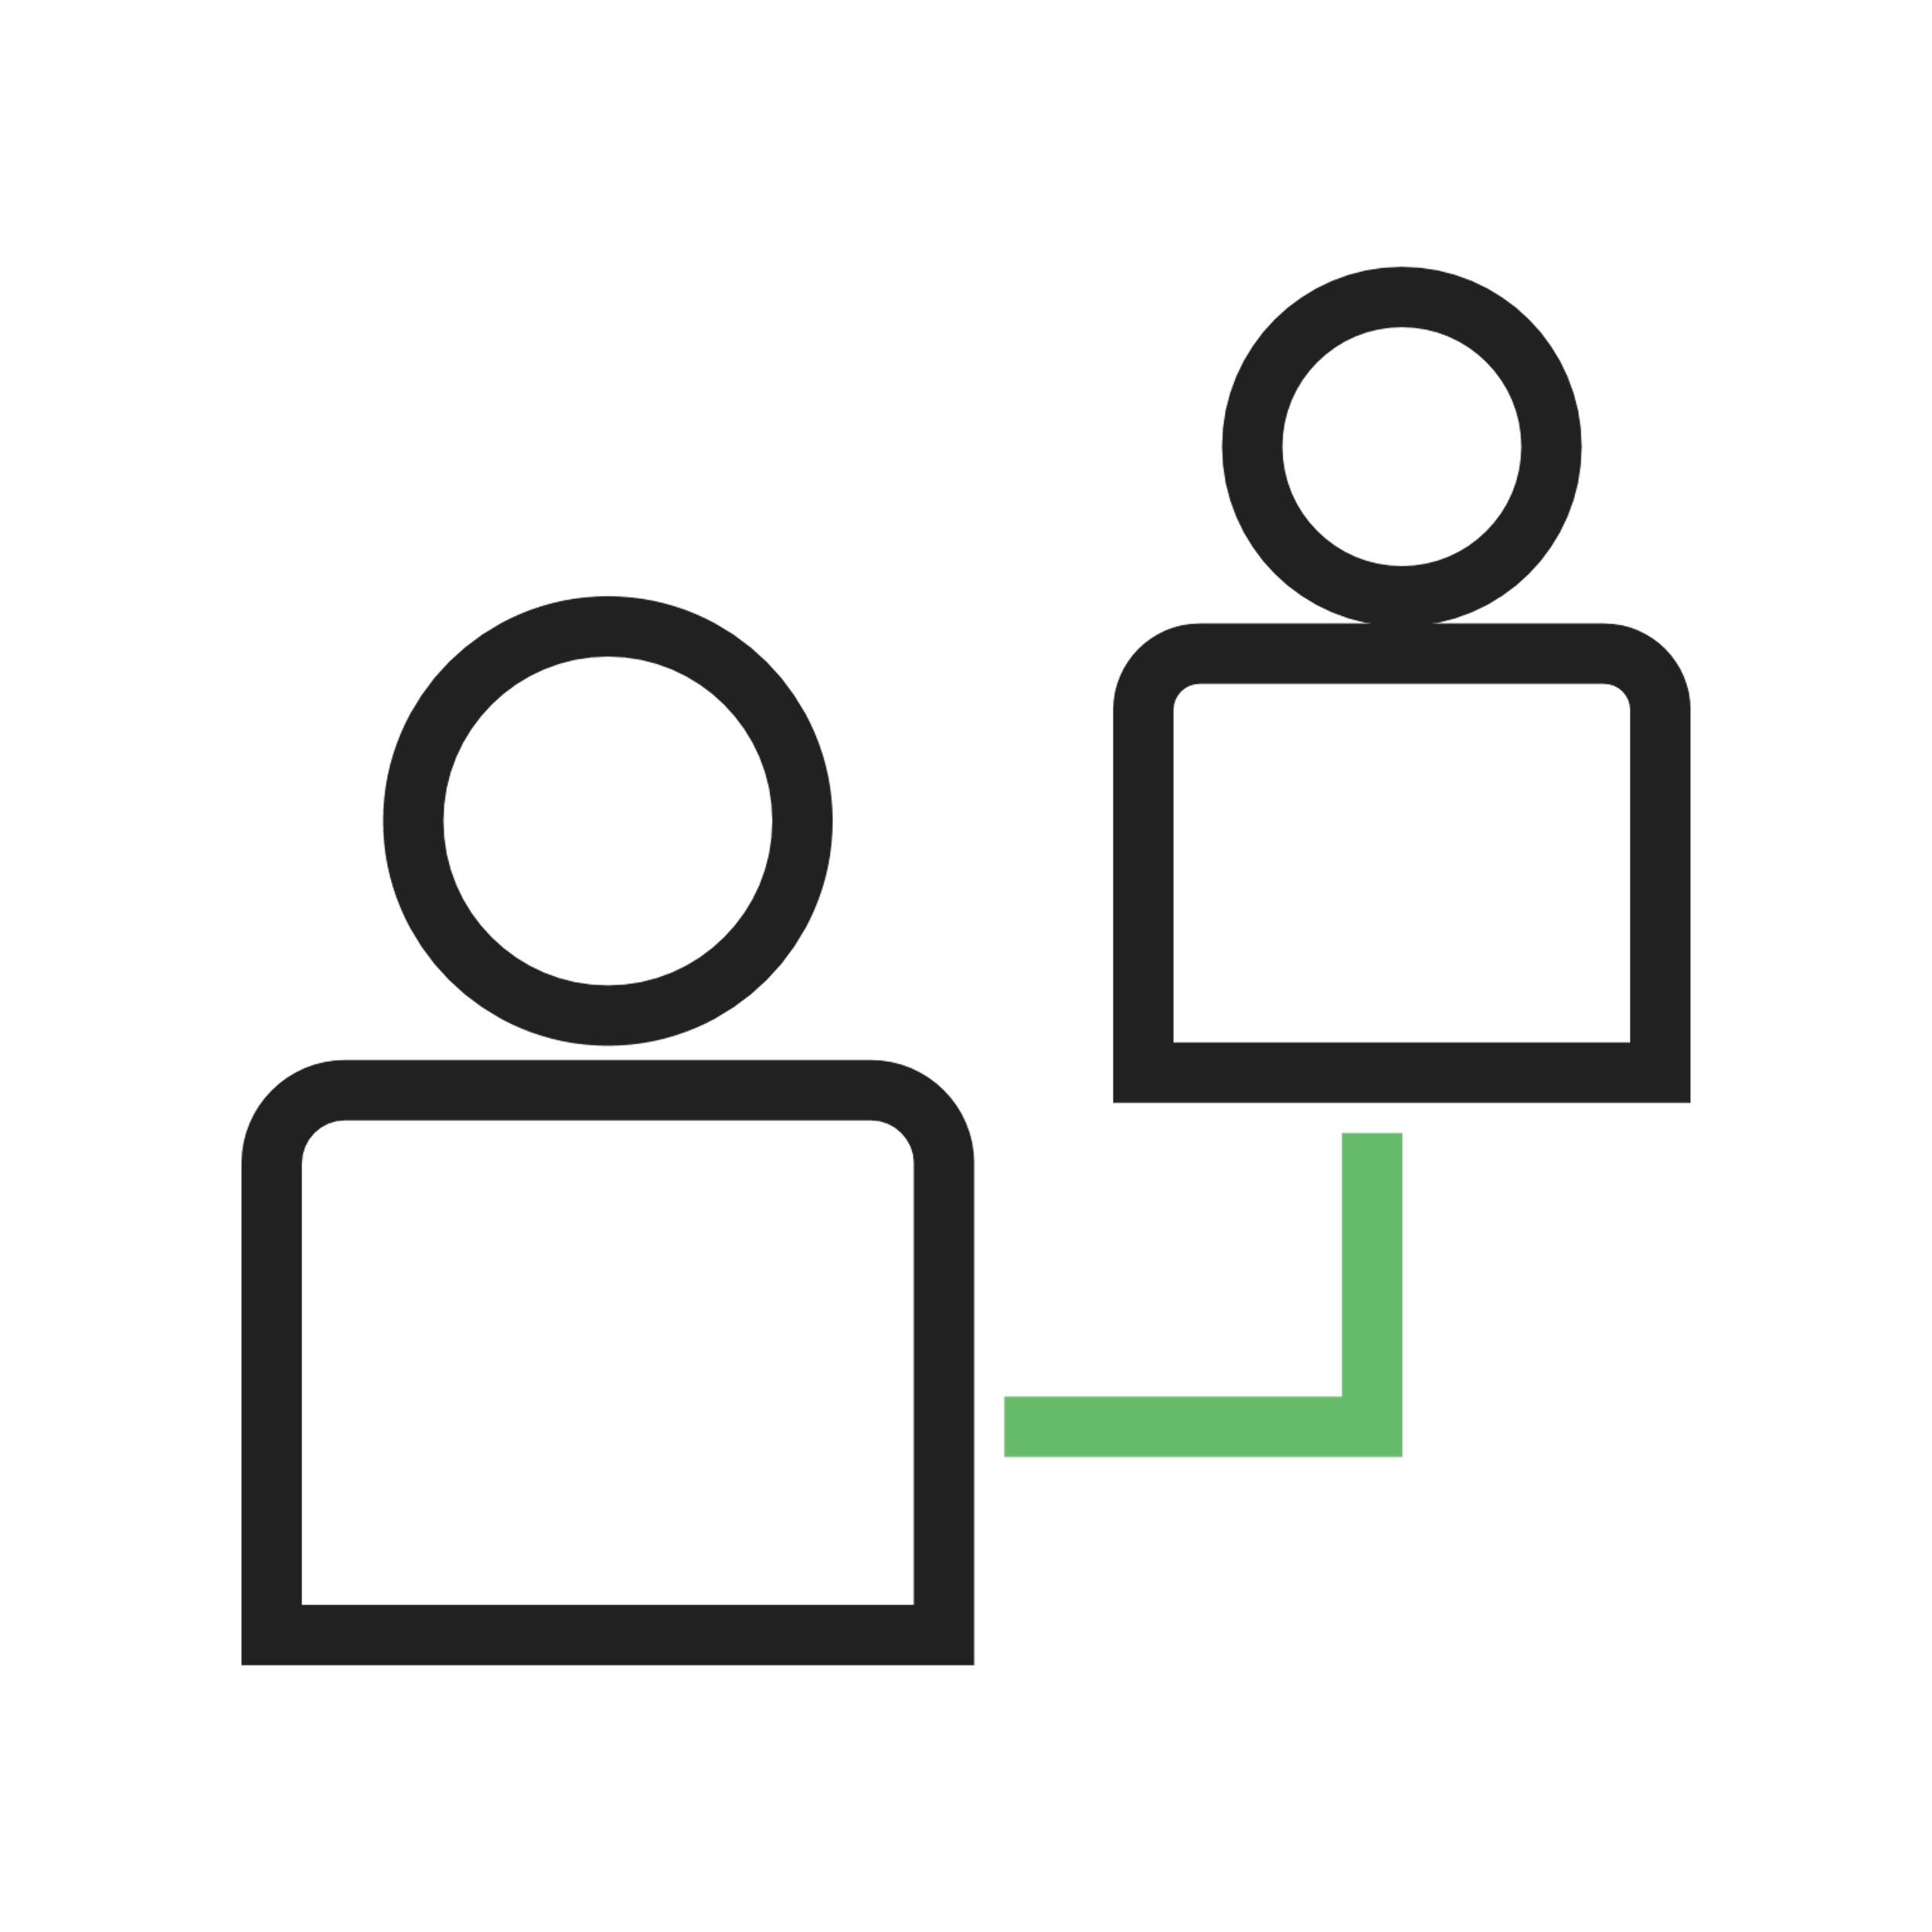
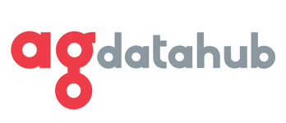














AgriDataSpace
18 months
March 2024
Architecture and data representation framework for an integrated and interoperable data space. Roadmap that guides the implementation of the future EU data space for agriculture based on the sector needs, including legal and ethical aspects.
October 2022
Consortium winning Horizon Europe Call: “Preparatory actions for the data space for Agriculture”
15 partners, 10 EU countries

Slide 15
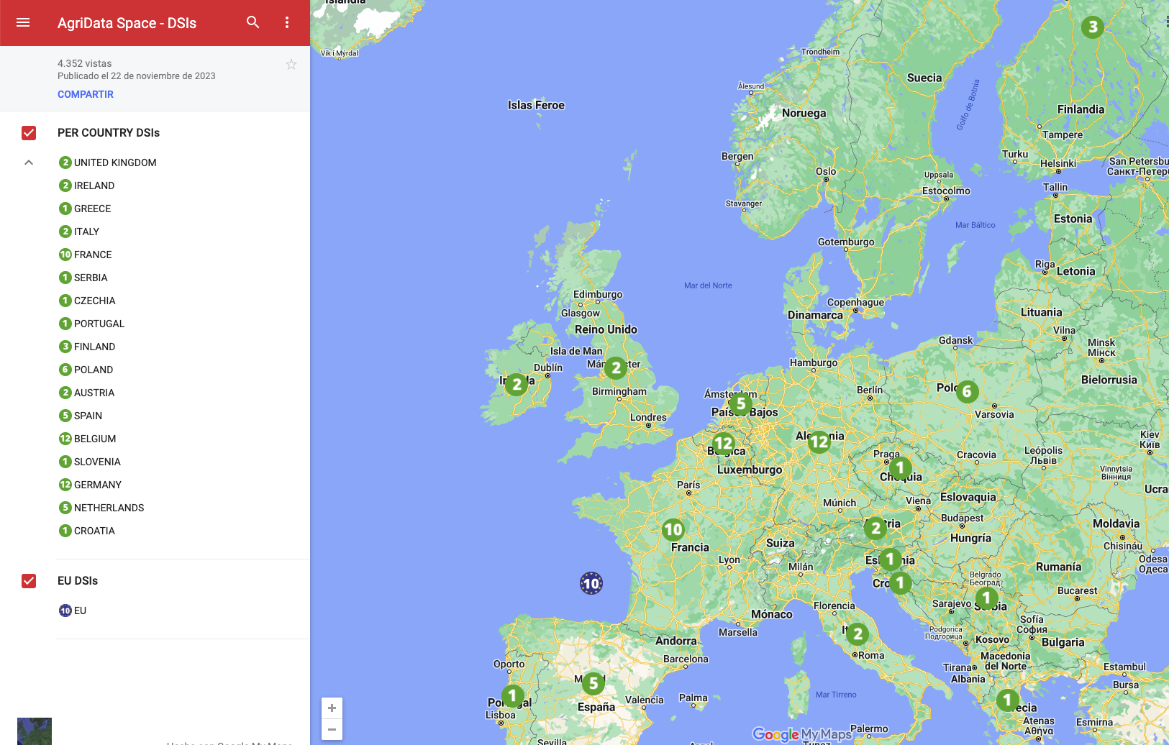
Agricultural Data Sharing Initiatives Map https://agridataspace-csa.eu/dsis-map/

Slide 16
Information Systems involved in Agriculture Data Sharing

Slide 17
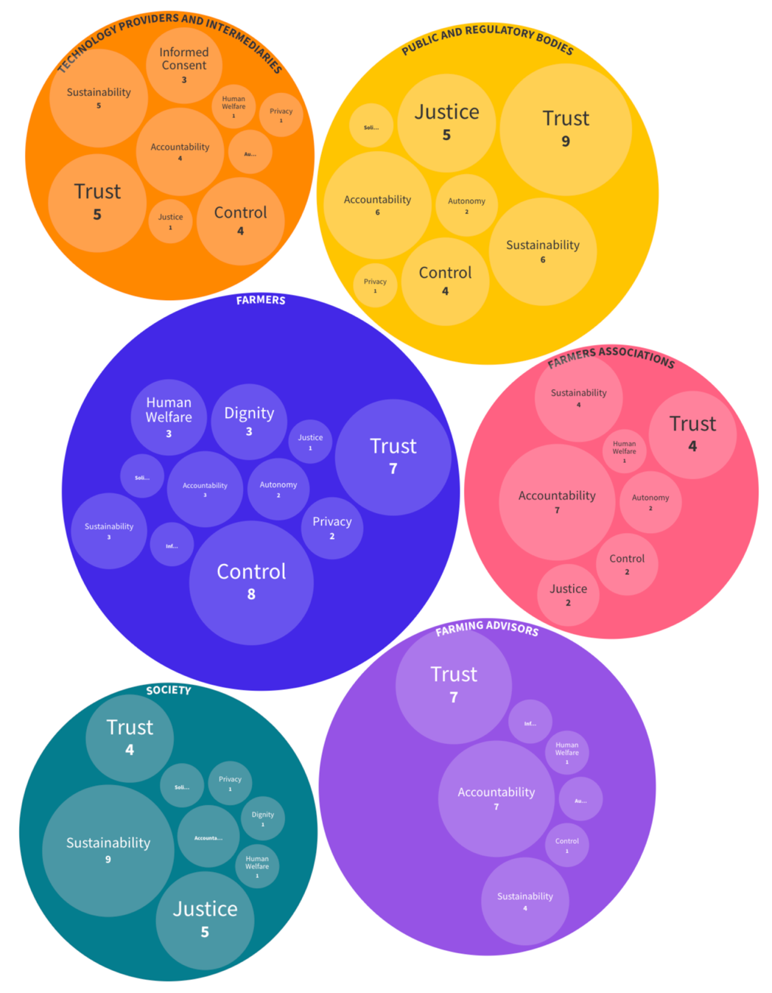

Agriculture Data Sharing Legal and Ethical Aspects
Starting points:
Data Act, Data Governance Act,...
”EU Code of conduct on agricultural data sharing by contractual agreement”
Ethical analysis
Value Sensitive Design of Agricultural Data Spaces

Slide 18
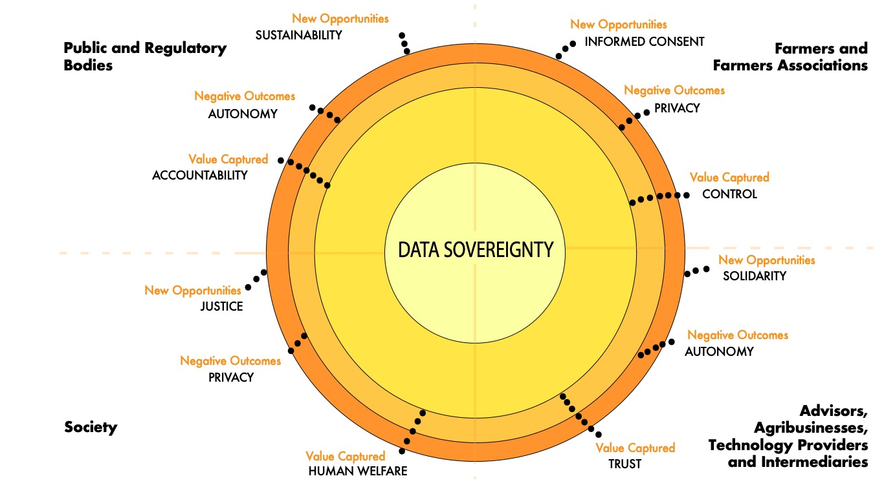
Data sovereignty in the Agriculture Data Space Value Mapping

Slide 19
Data Act
Users of connected products (including agriculture machines) have the right to access and share (with a third party of their choice) the data they have generated
Differentiate between:
‘product data’, the data generated by the use of a connected product
‘related service data’, which represents the digitalization of users' actions
‘readily available data’ mix of both these categories of data that can be shared without disproportionate effort by data holders
Personal data must be anonymized following the EU GDPR
Users can monetize non-personal granular data,
Data holders can license aggregated industrial data in return for a reasonable compensation
Data holders will have the right to refuse data access if disclosing trade secrets would lead to “serious and irreparable economic losses” or if there are specific safety requirements
Data processed through complex ‘proprietary algorithms’ excluded
https://www.twobirds.com/en/insights/2023/global/eu-institutions-reach-political-agreement-on-data-act

Slide 20
Data Governance Act
White Paper on the Definition of Data Intermediation Services, CiTiP Working Paper Series, https://ssrn.com/abstract=4589987

Slide 21
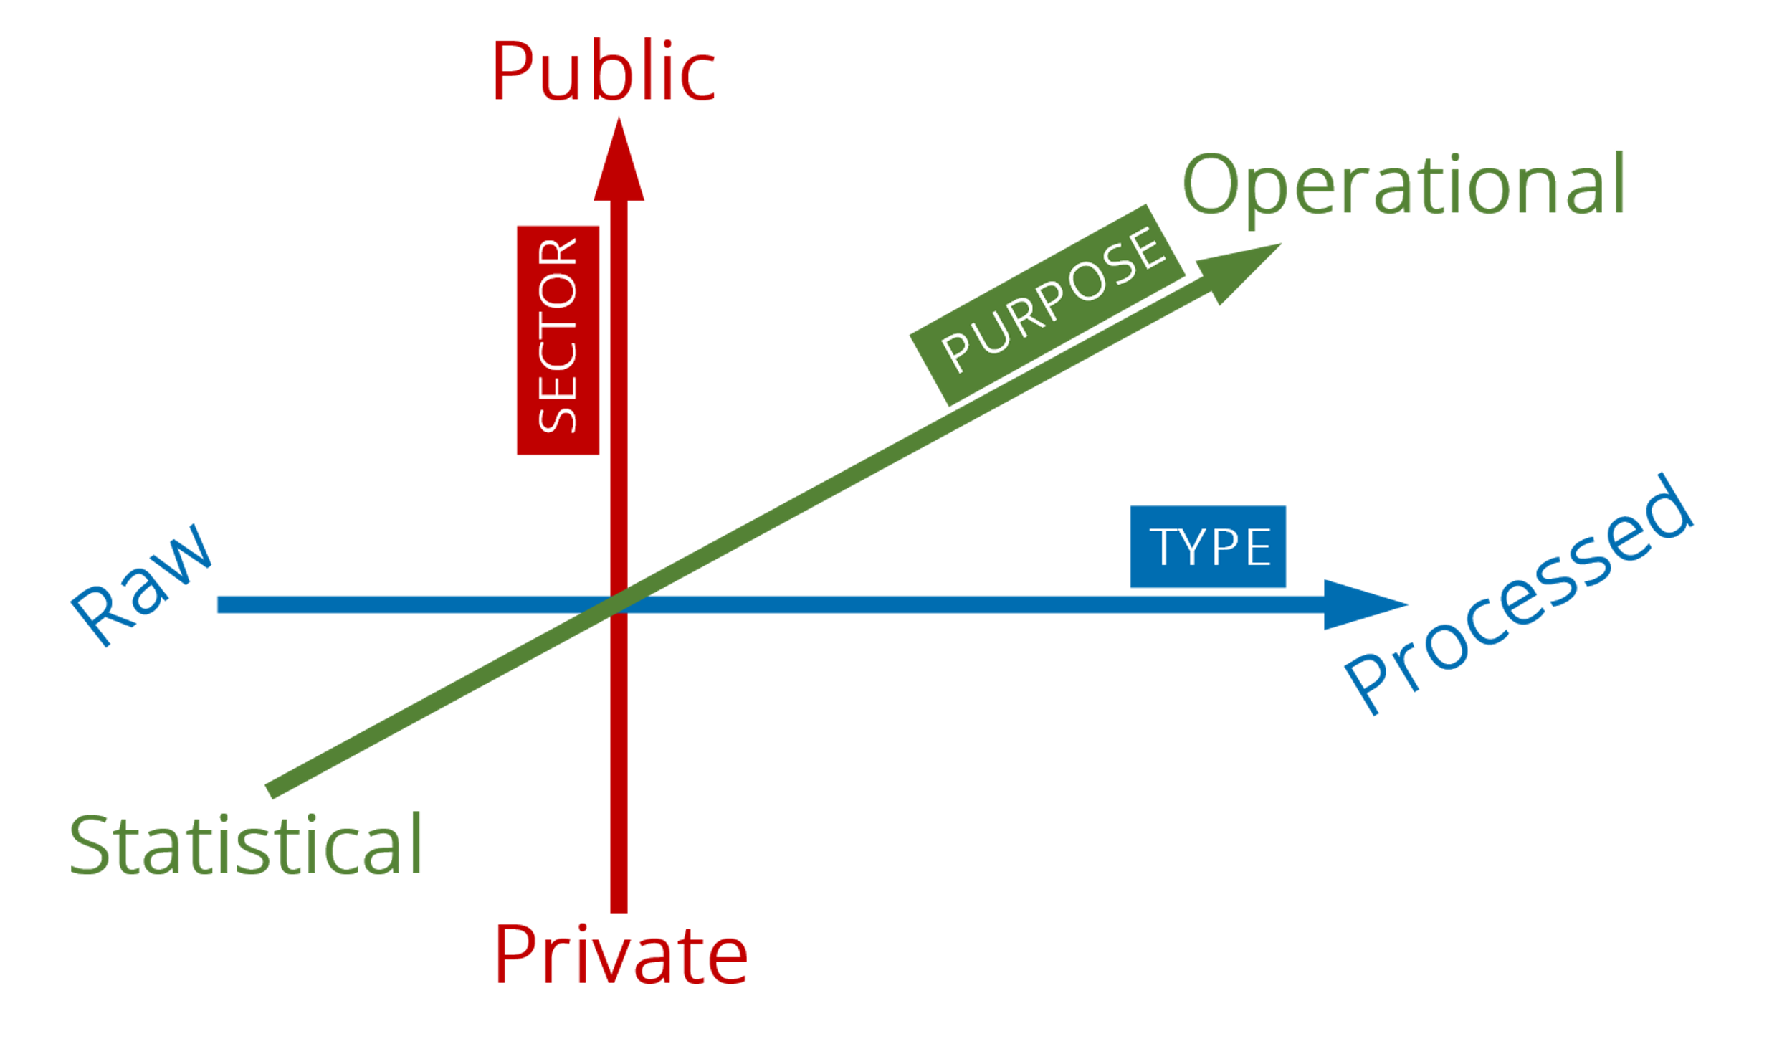
Technology Building Blocks
eID
Compliance as Code
Building Blocks CP
Access Control
GAIA-X
Keycloak
Trust & Sovereignty
OpenAPI
Compute to Data (CtD)
Common Identity F/W
CoC
IDSA
SCALABLE SOLUTIONS FOR GOVERNANCE
Marketplace & Clearinghouses
SIMPL
OOTS
EDC
DGA
General
Technologies
Functionality
Consent Control Dashboard
Data Economy
(DA)
Who are the Stakeholders
AGRI
Building Blocks DP
Agri Data Economy
Consent and Permission Management
Agritech Companies
TECHNICAL INTEROPERABILITY
Agri Ontologies & Data Models
Data Interoperability
Agri Standards
OEMs
Semantic Alignment
Data Processing
Laboratories
Mapping between Data Offers / DSIs
Data Sources
Public entities (i.e. PAs OpenData)
Data Visualisation
Notes:
The Once Only Technical System (OOTS) enables the sharing of information between public administrations across borders between EU countries.

Slide 22
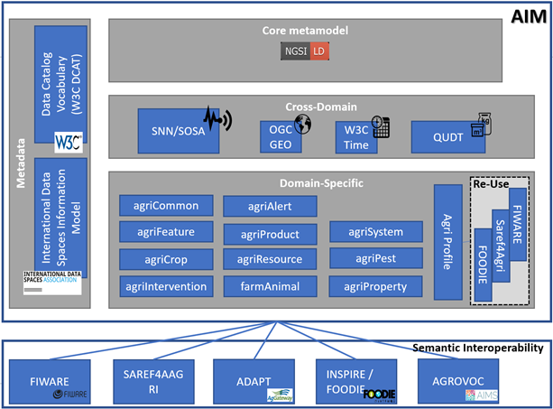
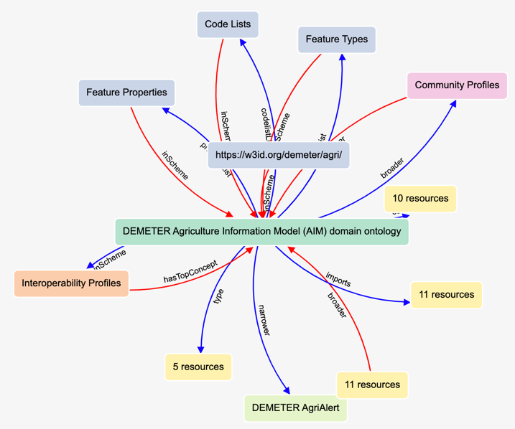
Vocabularies and Ontologies Agriculture Information Model (AIM)
https://w3id.org/demeter/agri
OGC Vocabulary:

Slide 23
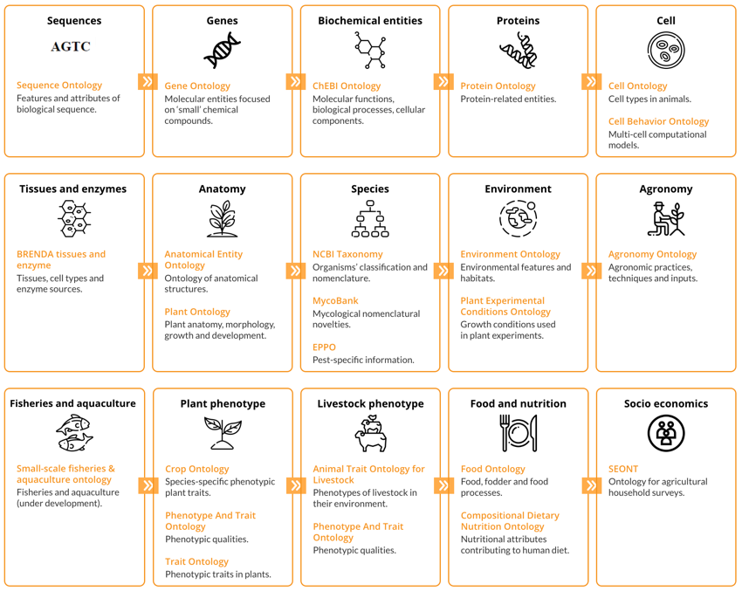
Vocabularies and Ontologies CGIAR: Ontologies most used in Agriculture
GENERIC ONTOLOGIES AND THESAURI
AGROVOC: Multilingual and controlled vocabulary designed to cover concepts and terminology under FAO’s areas of interest.
CAB Thesaurus: Controlled vocabulary for agriculture, forestry, horticulture, soil science, entomology, mycology, parasitology, veterinary medicine, nutrition, rural studies.
CG Core Metadata Schema: Minimum set of elements applicable for data and publication annotation and curation across CGIAR.
Comparative Data Analysis Ontology (CDAO): Formalization of concepts and relations relevant to evolutionary comparative analysis.
EMBRACE Data and Methods Ontology (EDAM): Comprehensive ontology for bioscientific data analysis and data management.
GAZ: Represents places through their names using an ontological approach to promote semantic coherence.
Geonames: Covers all countries and contains over eleven million placenames.
National Agricultural Library’s Agricultural Thesaurus and Glossary (NAL): Online vocabulary tools English and Spanish to select controlled vocabulary terms for subject indexing of AGRICOLA, PubAg and other databases.
Research Organization Registry (ROR): Registry of open, sustainable, usable, and unique identifiers for every research organization in the world.
Units of Measurement Ontology (UO): Ontology of units of measurements.
Variation Ontology (VariO): Ontology for standardized, systematic description of effects, consequences and mechanisms of variations.
VIVO Ontology: Open-source software and an ontology for representing scholarship.

Slide 24



The importance of Consent Management
Need to consider CoC and DGA and DA legislation
Additional requirements related to farmers as “data rights holders”
“low complexity” implications
Data rights holder
(i.e. farmers)
Data space enablers
(i.e. ID, trust providers)
Consent Management (1 : MANY)
Data providers
(i.e. ag machinery)
Data intermediaries
Data users

Slide 25
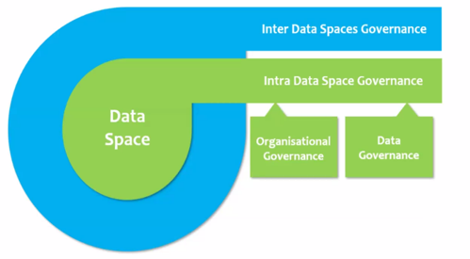
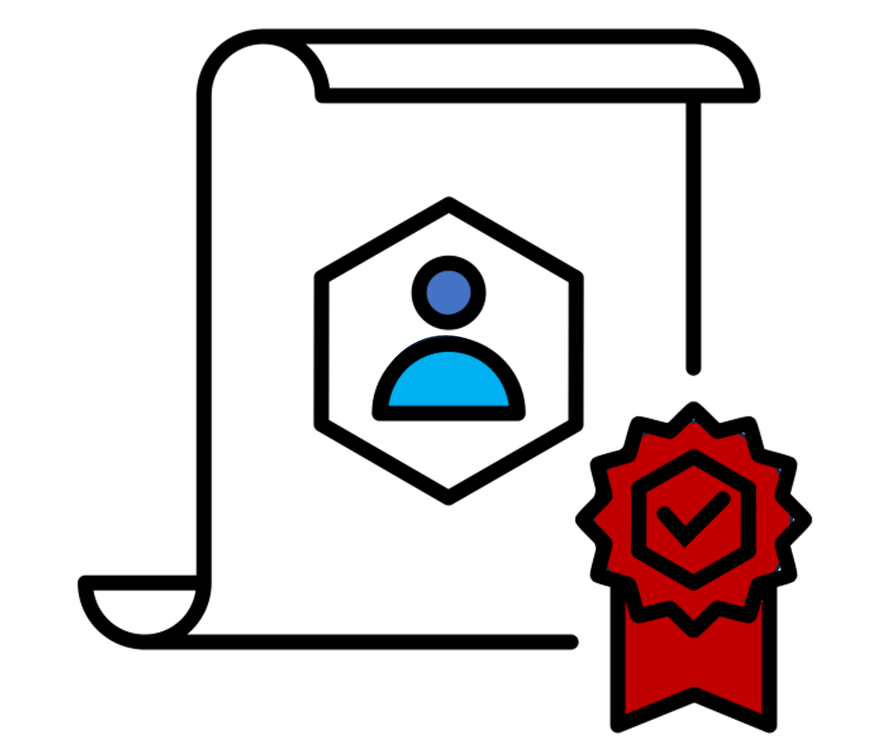
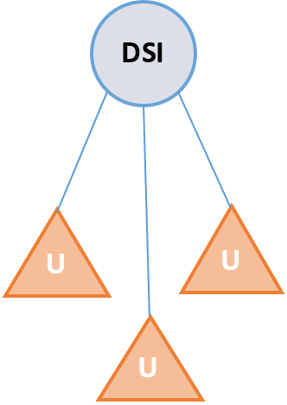
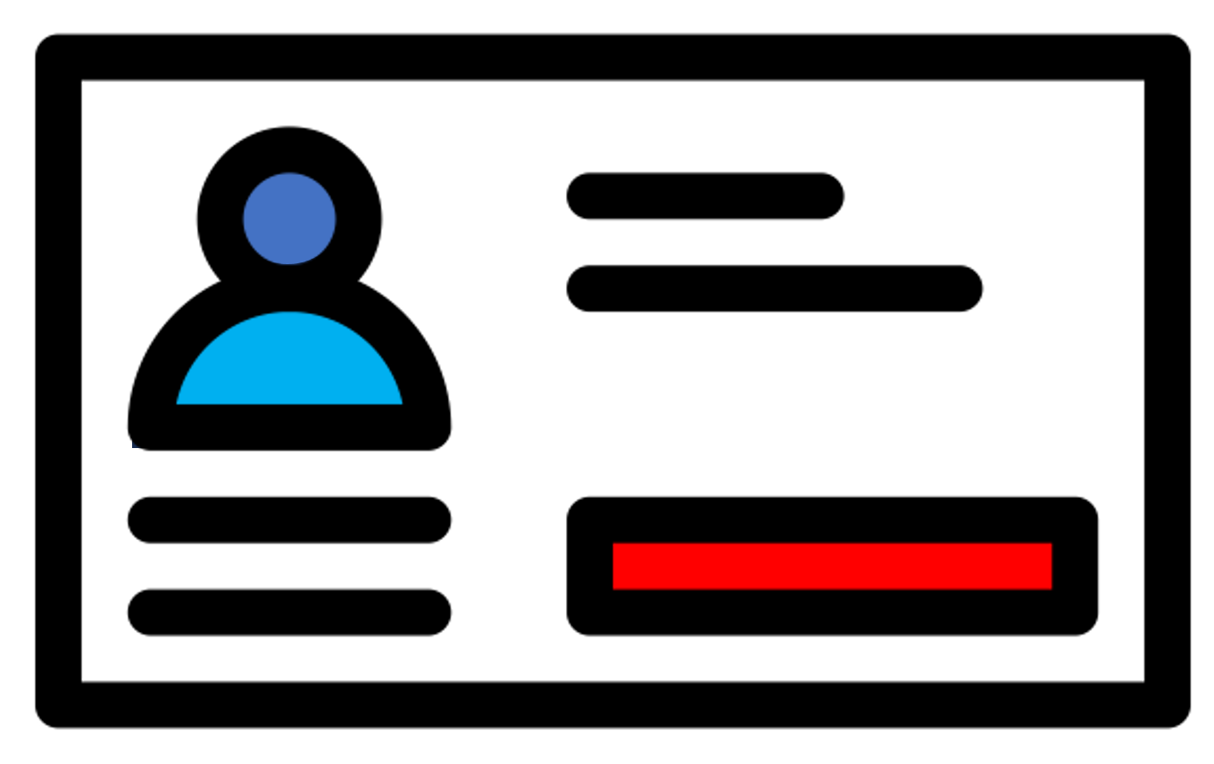

Data sovereignty and interoperability at technical level
Technical components for Data Sovereignty (two Users can exchange data acknowledging transactions)
Trust Identity Framework (basic requirement for recognising who is who - optional)
Data Models interoperability (basic understanding for parsing different data structures)
Semantic Alignment (mapping between existing ontologies in the agricultural domain)
MICRO LEVEL

Slide 26

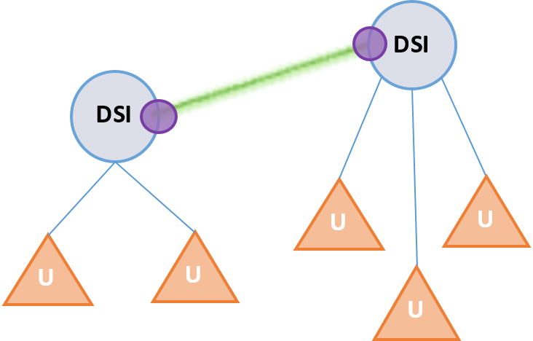

Strategical data sharing within same admin domain
The need for a Dataspace Connector (a common data space standard for preparing data offers)
Association of policies for usage, sharing of data
Some of the architectural components are not needed when data-sharing is strategical within the same entity (i.e. data-sharing between departments of same PA) and needs not to be supported by tracking and valorisation components
MICRO LEVEL

Slide 27

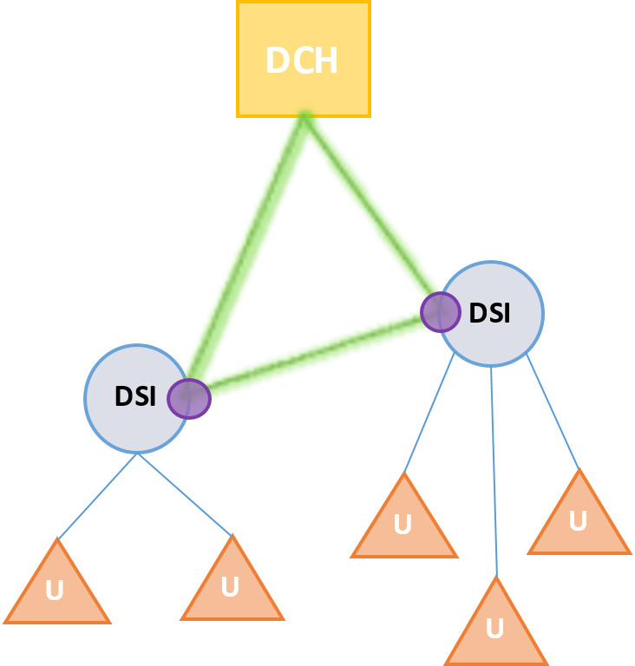

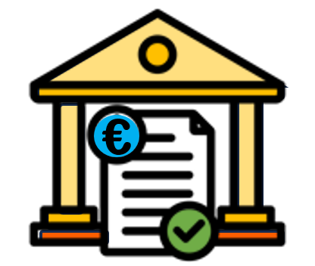
Towards a data economy in the agricultural sector
Expanding the architecture to support Macro-level scenarios
Shared Trust Identity Framework (basic requirement for recognising who is who - mandatory)
Metadata Brokers and Data Catalogues to view what’s on offer
Data Clearing Houses to track data exchange
MACRO LEVEL

Slide 28

Scenario for CEADS structure
European Agri Data Space
Other European Data Space
International Agri Data Space
Macro
level
Data Sharing Initiatives
Micro
level

Slide 29
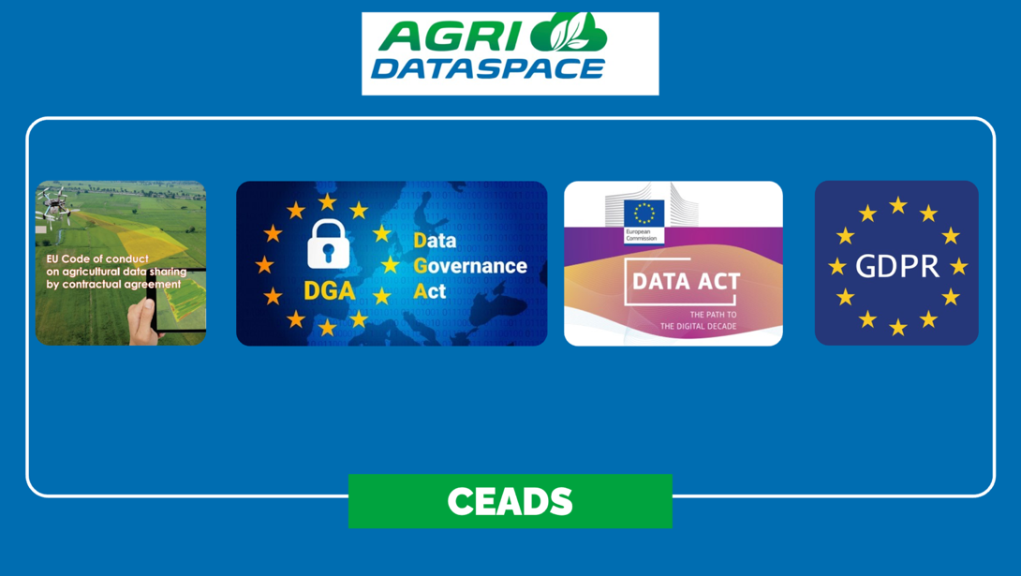
Governance of data sharing
Participants
Legal compliance
Technical compliance
Data clearing house
Principles for data intermediaries: neutral, non-discriminatory, security, restriction of data usage
Portability
Accessibility of data by design
Access to users
Data sovereignty, also for primary producers
Connectors
Domain standards
Minimum level of tech interoperability
Identity verification
Consent management
Data catalogue
Business compliance
DGA for DISPs
Interoperable business models
Agree with fees

Slide 30
Heterogeneity of business models
Business models:
Data monetisation
Data marketplace
Software as a service (Saas)
Industrial and data platforms
Technical enablers
Open data policy
Revenue models:
Free-to-all
Freemium
Licensing
Sponsorship / Branded advertisement
Demand Oriented
Barter system
Other
Type of organisation:
private / public / both
Legal form:
Profit oriented: yes / no
Geography: country(ies)
Notes:
Incentive to share data

Slide 31
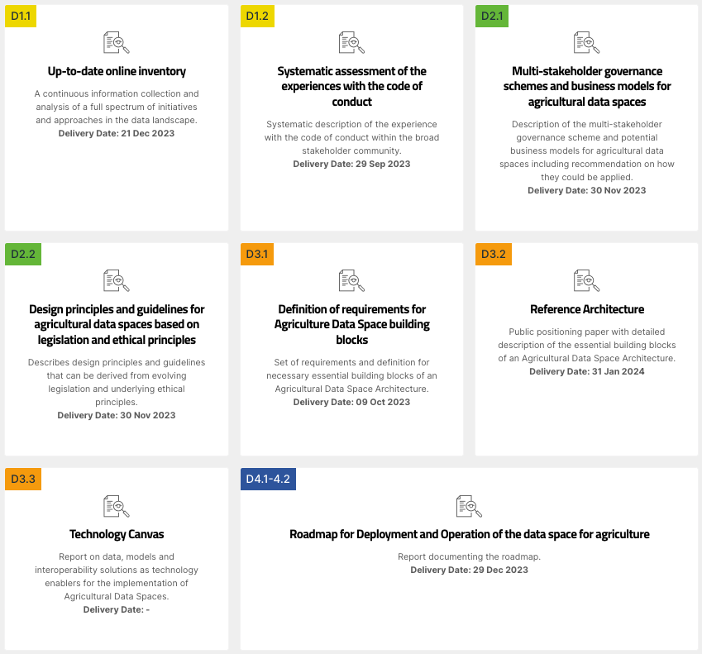
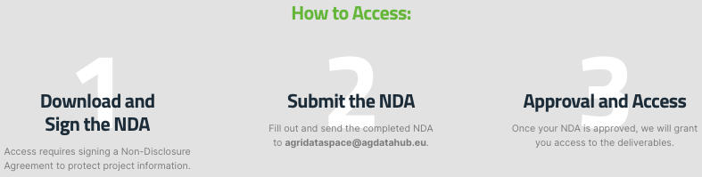
More details...
https://agridataspace-csa.eu/deliverables/

Slide 32
Thank you for your attention Questions?
Roberto García
Universitat de Lleida
roberto.garcia@udl.cat

